Slide 1
Study Source
Alice, Mark, Florent, Daniel

Slide 2
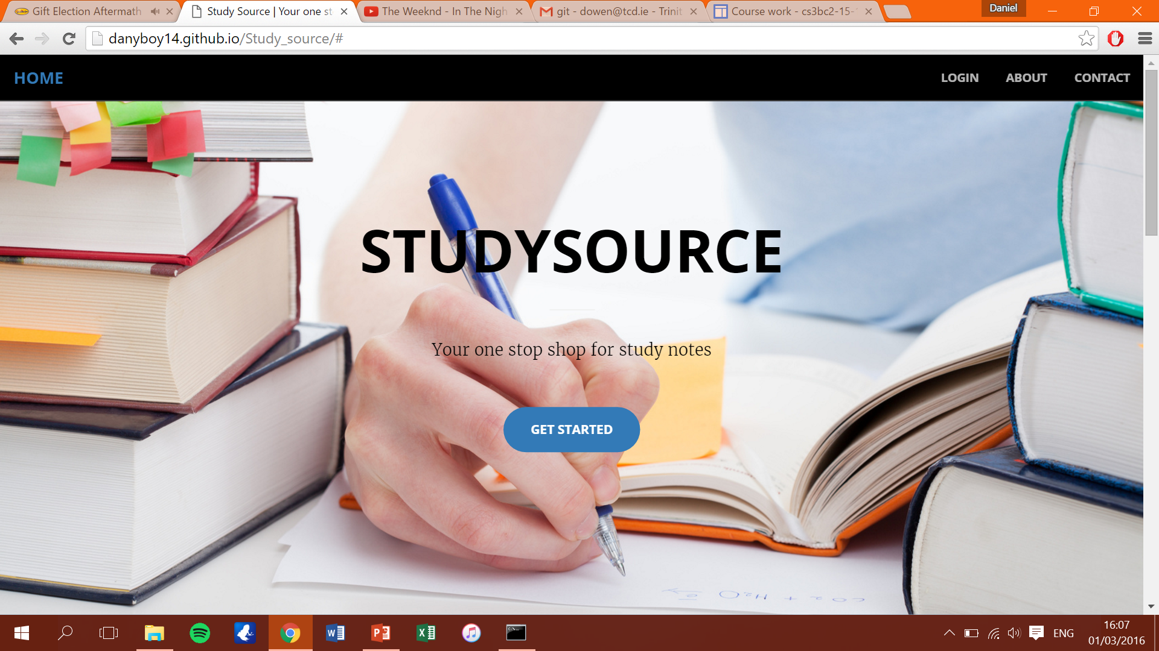
Website address: danyboy14.github.io/Study_source
This is our website hosted on Github which is in its present state online.

Slide 3
Features in place
home page.
Our website fully supports new users who are looking to sign up to the service.
We have a section for Leaving Cert notes and one for College notes, which allows users to browse our library of notes by topic, and also to search for the notes they want

Slide 4
Features yet to be implemented
Allow users to upload notes
Allow users to purchase notes
Allow users to rate notes purchased

Slide 5
Evaluation of design

Slide 6
Problems encountered so far

Slide 7
Plan for completing the application

